Slide 1
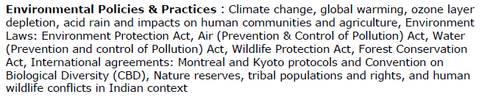
Unit 5

Slide 2
Environmental acts

Slide 3
The Environment Protection act 1986
Objective- It provides for the protection and conservation of the Environment.
Key notes of the act;
Under the Act, a central government may provide permission for various works related to urbanization.
Protection against natural hazards
Maintenance of water supply in aquifers.
Protection of lines of communication and transportation
Preservation of public health.

Slide 4
Air (Prevention and Control of Pollution) Act of 1981
Objective- It provides the prevention , control and abatement of air pollution. Provisions of the Act has to be implemented by Central Pollution Control Board along with the state board.
Functions-
setting of the air quality standards, collecting data on air pollution, organizing training, awareness programmes, establishing laboratories
Specify air pollution control areas and set standard for vehicle emissions.
Penalties for violation of its provisions. Applies to all.

Slide 5
Water (Prevention and Control of Pollution) Act 1974
Objective-
It prevents, controls and provides maintenance or restoration of wholesomeness of water.
Provisions of the Act has to be implemented by Central Pollution Control Board being a main agency.
Functions-
Establishes standards of the water quality and effluent
Polluting industries must seek the permission to discharge the waste into effluent bodies.

Slide 6
Wildlife Protection Act of 1972
Objective-
Wildlife protection Act of 1972 defines wildlife to include any bird or animal and aquatic or land vegetation, form part of any habitat.
Function-
Under the Act, Central government work with state governments to regulate or prohibit the conversion of forest in agriculture or urban land.
Protection against natural hazards
Maintenance of water supply in water bodies present in Forest.
Protection of lines of communication and transportation

Slide 7
Forest Conservation Act of 1980
Objective-
It provides for the protection and conservation of the forests.
Under the Act, a state government may regulate or prohibit in any forest the clearing of land for cultivation, pasturing of cattle, or clearing the vegetation for any of following purposes:
Function-
Protection against natural hazards
Maintenance of water supply in aquifers.
Protection of lines of communication and transportation
Preservation of public health.
Mandatory for land owner.

Slide 8
Issues involved in enforcement of Env Laws
Illiteracy
Growing population
Ignorance
Economic reasons
Insufficiency of laws

Slide 9
Environment Laws:
https://www.youtube.com/watch?v=CTUOchYZG2k
Environment protection act:
https://www.youtube.com/watch?v=hPgBLOZ85Cw
Air act:
https://www.youtube.com/watch?v=0Vszm8Pj1uY
Water act
https://www.youtube.com/watch?v=eNbP0L2Ecoo
Wild life conservation act
https://www.youtube.com/watch?v=tYJOd-QYidc
https://www.youtube.com/watch?v=mzaNyNVcAnA
Forest conservation act:
https://www.youtube.com/watch?v=6U_4jX4engM
https://www.youtube.com/watch?v=y1JJMYWyL68

Slide 10
Kyoto Protocol
The Kyoto Protocol to the United Nations Framework Convention on climate change is an amendment to the international treaty on climate change:
It assigns mandatory emission limitations for the reduction of green house gas emission to the signatory nations.
The objective of Protocol is “Stabilization of greenhouse gas concentrations in the atmosphere at a level that would prevent dangerous anthropogenic interference with the climatic system”
Montreal Protocol
Designed to protect the ozone layer by phasing out the production of a number of substances believed to be responsible for ozone depletion

Slide 11
Convention on Biological Diversity
The conservation of biodiversity is a common concern of humankind. The CBD covers biodiversity at all levels: Ecosystems, species and genetic resources.
The Convention on Biological Diversity (CBD) is an international legally-binding treaty with three main goals: conservation of biodiversity; sustainable use of biodiversity; and the fair and equitable sharing of the benefits arising from the use of genetic resources. Its overall objective is to encourage actions which will lead to a sustainable future.

Slide 12
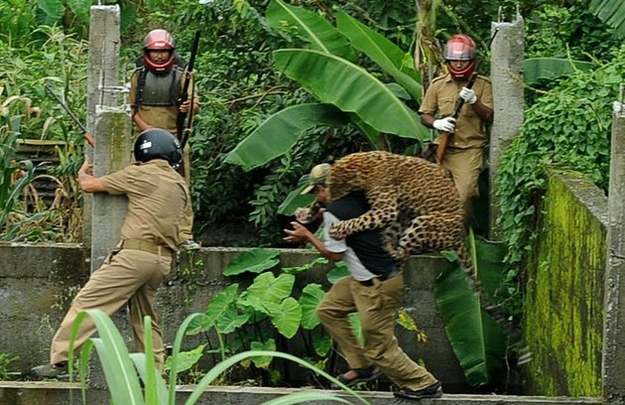
Human - wildlife conflict in India

Slide 13
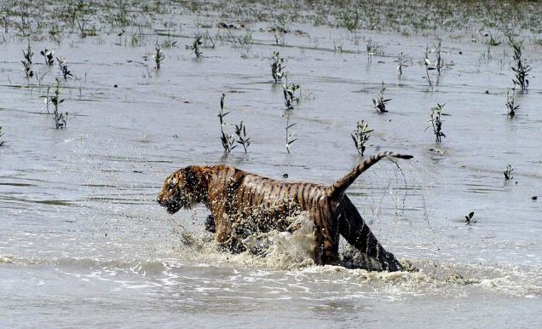
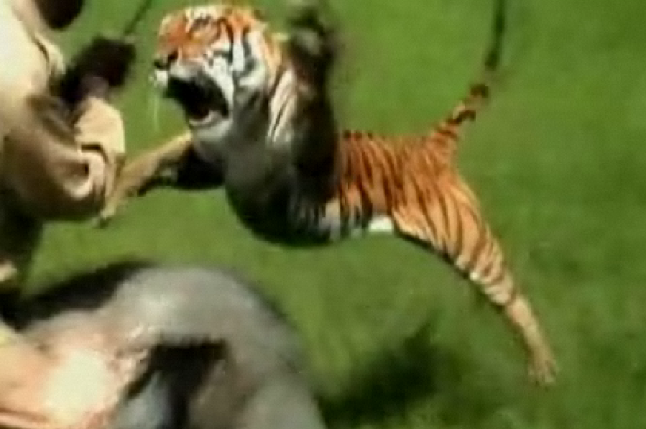
Human wild life conflict in India

Slide 14
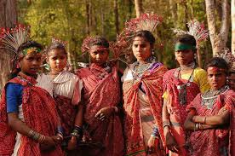
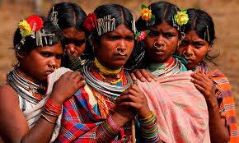
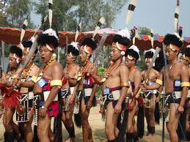
tribal population and rights in India
India's forests are home to crores of people, including many Scheduled Tribes, who live in or near the forest areas of the country. Nearly 250 million people live in and around forests in India, of which the estimated indigenous Adivasi or tribal population stands at about 100 million.

Slide 15
Imtroduction and features of Kyoto Protocol
https://www.youtube.com/watch?v=yXRGwHZxi6A(Kyoto)
Basics of Kyoto Protocol
https://www.youtube.com/watch?v=aXdmqXG3ITU
Why the Kyoto Protocol Failed
https://www.youtube.com/watch?v=bcxL7jN4akw
Kyoto Protocol's success, criticism and the future
https://www.youtube.com/watch?v=mNhMCE6S0r8
Montreal Protocol Documentry
https://www.youtube.com/watch?v=lksYRyagxp4
Montreal Protocol on Substances that Deplete the Ozone Layer
https://www.youtube.com/watch?v=1irQmkReDIo
A video on the ozone hole, climate change and the works of the Montreal Protocol on substances that deplete the ozone layer.
https://www.youtube.com/watch?v=tnp0YU3u1r4
Action Now for Life on Earth
https://www.youtube.com/watch?v=2uRTHoLpoLE

Slide 16
World Wide Views on Biodiversity 2012 - Documentary
https://www.youtube.com/watch?v=r5sCJEEXsTE
Land Rights Initiative Delhi Conference to protect tribal populations
https://www.youtube.com/watch?v=mFw8oakAX-g
Scheduled Tribes and other Traditional Forest Dwellers (Recognition of Forest Rights)
https://www.youtube.com/watch?v=lmrGwt2Gj9M
Issues related to the culture, identity, lifestyle and livelihood of the tribals.
https://www.youtube.com/watch?v=e7D7H37bxsE
Human Wildlife Conflict in the Sundarbans
https://www.youtube.com/watch?v=o2yyUl_smGE
Documentry to reduce HUMAN WILDLIFE CONFLICT
https://www.youtube.com/watch?v=O9-wekzDfRo
Imtroduction and features of Kyoto Protocol
https://www.youtube.com/watch?v=yXRGwHZxi6A(Kyoto)
Basics of Kyoto Protocol
https://www.youtube.com/watch?v=aXdmqXG3ITU
Why the Kyoto Protocol Failed
https://www.youtube.com/watch?v=bcxL7jN4akw

Slide 17
7. When did the Kyoto Protocol entered into force?
a) 1997
b) 2000
c) 2005
d) 2009
8. When is the first commitment period for the Kyoto Protocol expired?
a) 2007
b) 2010
c) 2012
d) 2015

Slide 18
7. When did the Kyoto Protocol entered into force?
a) 1997
b) 2000
c) 2005
d) 2009
Explanation: The Kyoto Protocol Is an international treaty that commits to reducing greenhouse gas emission. It was adopted in Kyoto, Japan, On December 11, 1997. It later on February 16, 2005 it entered into forces.
8. When is the first commitment period for the Kyoto Protocol expired?
a) 2007
b) 2010
c) 2012
d) 2015
Explanation: The first commitment period for the Kyoto Protocol expired on 31 December 2012 which came into effective force from 16 February 2005. Kyoto Protocol Extension was drafted on December 8, 2012. This extension is expired in 2020.

Slide 19
Based on what the Kyoto Protocol set emission reduction targets for the group of greenhouse gases?
a) Hydrogen equivalents
b) Carbon dioxide equivalents
c) Oxygen equivalents
d) Nitrogen equivalents
2. Under how many agreements fluorochemicals are regulated?
a) One
b) Two
c) Three
d) Four

Slide 20
1. Based on what the Kyoto Protocol set emission reduction targets for the group of greenhouse gases?
a) Hydrogen equivalents
b) Carbon dioxide equivalents
c) Oxygen equivalents
d) Nitrogen equivalents
Explanation: The Kyoto Protocol set emission reduction targets for a group of greenhouse gases including hydrofluorocarbons based on their carbon dioxide equivalents. Carbon dioxide is one of the highly emitted gases.
2. Under how many agreements fluorochemicals are regulated?
a) One
b) Two
c) Three
d) Four
Explanation: Fluorochemicals are regulated under two international agreements. Those agreements are the Montreal Protocol and Kyoto Protocol. Both these agreements work towards the better climatic conditions of the planet.

Slide 21
3. With minor exception, which of the following have been phased out completely globally?
a) Carbon dioxide
b) Carbon monoxide
c) Chlorofluorocarbons
d) Nitrogen dioxide
4. For what production and consumption phase out schedules the Montreal Protocol has established?
a) Greenhouse emitting gases
b) Global warming emitting gases
c) Ozone layer depleting substances
d) Water level increasing substances

Slide 22
3. With minor exception, which of the following have been phased out completely globally?
a) Carbon dioxide
b) Carbon monoxide
c) Chlorofluorocarbons
d) Nitrogen dioxide
Explanation: Chlorofluorocarbons (CFCS) is one of the ozone depleting substances. Release of chlorofluorocarbons leads to the damage of the ozone layer. With a very minor exception, CFCs have been phased out globally.
4. For what production and consumption phase out schedules the Montreal Protocol has established?
a) Greenhouse emitting gases
b) Global warming emitting gases
c) Ozone layer depleting substances
d) Water level increasing substances
Explanation: The Montreal Protocol has established production and consumption phase out schedules for chlorofluorocarbons, hydro chlorofluorocarbons and other ozone layer depleting substances and protecting ozone.

Slide 23
5. How can be determined carbon dioxide equivalents?
a) By multiplying the quantity of the gas by its global warming potential
b) By multiplying the quantity of the gas by its pressure
c) By multiplying the quantity of the water by its global warming potential
d) By multiplying the quantity of the gas by its global cooling potential
6. The Montreal Protocol is less known for its role in climate protection.
a) True
b) False

Slide 24
5. How can be determined carbon dioxide equivalents?
a) By multiplying the quantity of the gas by its global warming potential
b) By multiplying the quantity of the gas by its pressure
c) By multiplying the quantity of the water by its global warming potential
d) By multiplying the quantity of the gas by its global cooling potential
Explanation: Based on the carbon dioxide equivalents the Kyoto Protocol set emission reduction targets. The carbon dioxide equivalent of a gas is determined by multiplying the quantity of the gas by its global warming potential.
6. The Montreal Protocol is less known for its role in climate protection.
a) True
b) False
Explanation: The Montreal Protocol is well known for protecting stratospheric ozone. But it is less known for its role in climate protection. The reason for this is, the Kyoto Protocol aims to the reduction of green house gas while the Montreal protocol works on the ozone layer depleting gases.

Slide 25
9. When did the Montreal Protocol entered into force?
a) 1984
b) 1986
c) 1989
d) 1994
10. What are the substances present in the ozone layer depleting substances controlled by the Montreal Protocol?
a) Either chlorine or bromine
b) Either carbon or nitrogen
c) Either chlorine or carbon
d) Either carbon or bromine

Slide 26
9. When did the Montreal Protocol entered into force?
a) 1984
b) 1986
c) 1989
d) 1994
Explanation: The Montreal Protocol is an international treaty on substances that depleting the ozone layer and it is designed to protect the ozone layer. The Montreal Protocol was agreed on 16 September 187 and entered into force on 1 January 1989.
10. What are the substances present in the ozone layer depleting substances controlled by the Montreal Protocol?
a) Either chlorine or bromine
b) Either carbon or nitrogen
c) Either chlorine or carbon
d) Either carbon or bromine
Explanation: All the ozone layer depleting substances controlled by the Montreal Protocol contain either chlorine or bromine. Some ozone depleting substances are not yet controlled by the Montreal Protocol for example nitrous oxide.

Slide 27
11. Why hydrofluorocarbons are no harm to the ozone layer?
a) Because they contain chlorine
b) Because they do not contain chlorine
c) Because they contain carbon
d) Because they contain nitrogen
12. Which Amendment was agreed to phase down HFCs under the Montreal Protocol?
a) Paris Amendment
b) New York Amendment
c) Delhi Amendment
d) Kigali Amendment

Slide 28
11. Why hydrofluorocarbons are no harm to the ozone layer?
a) Because they contain chlorine
b) Because they do not contain chlorine
c) Because they contain carbon
d) Because they contain nitrogen
Explanation: Hydrofluorocarbons (HFCs) are not harm to the ozone layer because unlike CFCs they do not contain chlorine in it. But they are greenhouse gases with a high global warming potential. Hence through Montreal Protocol fast phase down of high global warming potential HFCs are taking into action.
12. Which Amendment was agreed to phase down HFCs under the Montreal Protocol?
a) Paris Amendment
b) New York Amendment
c) Delhi Amendment
d) Kigali Amendment
Explanation: The parties to the Montreal Protocol adopted the Kigali Amendment in October 2016 in Kigali. This Amendment agreed the parties to phase down HFCs production and consumption under the Montreal Protocol.

Slide 29
13. Which one of the following is the objective of Kyoto Protocol?
a) Stabilization and reconstruction of greenhouse gases
b) Protecting the ozone layer from depletion
c) Reducing the CFCs and HFCs usage
d) Increasing the greenhouse gases
14. The Montreal Protocol is the successful climate agreement.
a) True
b) False

Slide 30
13. Which one of the following is the objective of Kyoto Protocol?
a) Stabilization and reconstruction of greenhouse gases
b) Protecting the ozone layer from depletion
c) Reducing the CFCs and HFCs usage
d) Increasing the greenhouse gases
Explanation: One of the main objectives of the Kyoto Protocol is the stabilization and reconstruction of greenhouse gas concentration in the atmosphere at a level that would prevent damages causing to the climate.
14. The Montreal Protocol is the successful climate agreement.
a) True
b) False
Explanation: The Montreal Protocol has resulted in 99$ phase-out of CFCs and other harmful ozone depleting substances. Kigali Amendment contributes to avoiding 0.5 degree Celsius of globally warming through reducing HFCs that are powerful global warming potentials.

Slide 31
Thank you

